Slide 1

How to Search
Notes:
Please retain proper attribution, including the reference to ai.berkeley.edu. Thanks!

Slide 2
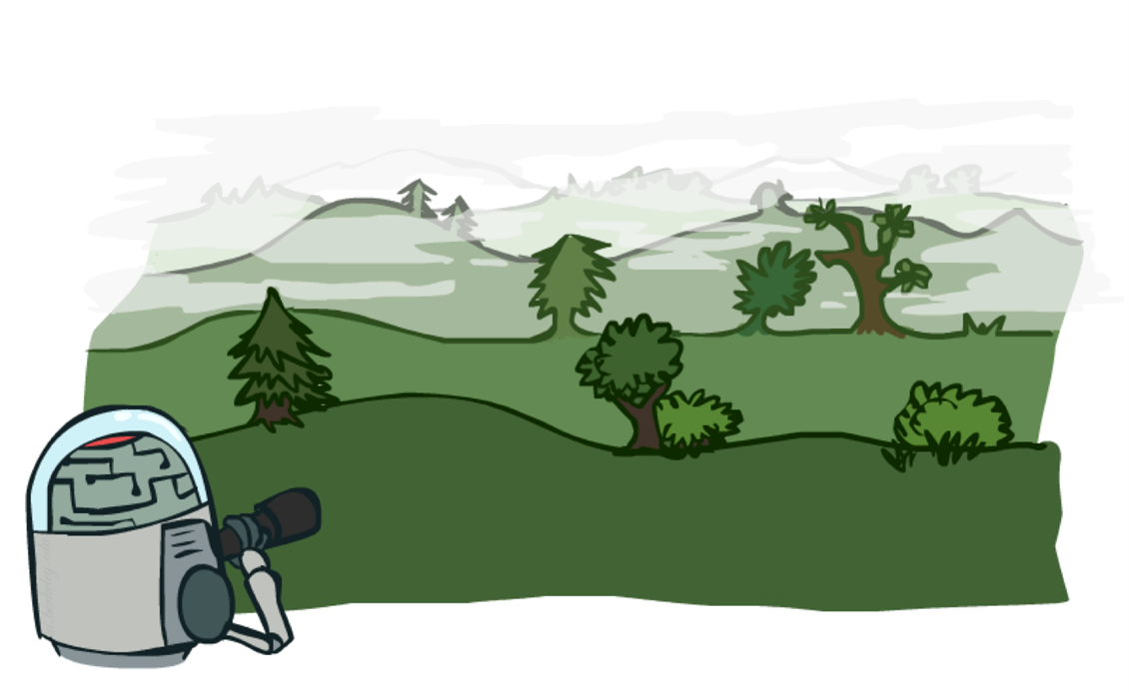
What is “Search”?
“Search” in Computer Science refers to the ability of an Intelligent System to find an action plan that is optimal, given an start state, goal state and reward function.
Notes:
General theme in the class:
A goal we have in mind.
A mathematical abstraction to formalize this
Algorithms that operate on these abstractions

Slide 3

What happens when you don’t plan?
Notes:
Examples: blinking your eye (not using your entire thinking capabilities), vacuum cleaner moving towards nearest dirt

Slide 4
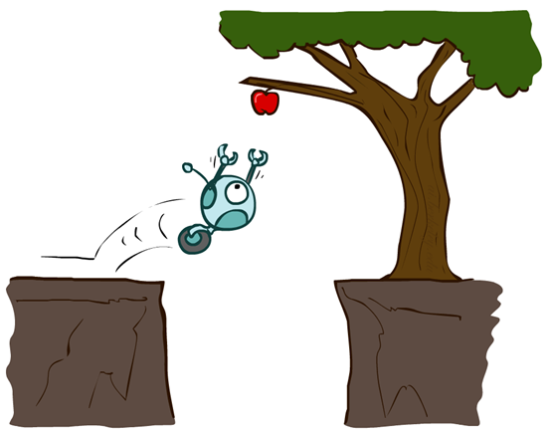
Agents that don’t Plan

Slide 5
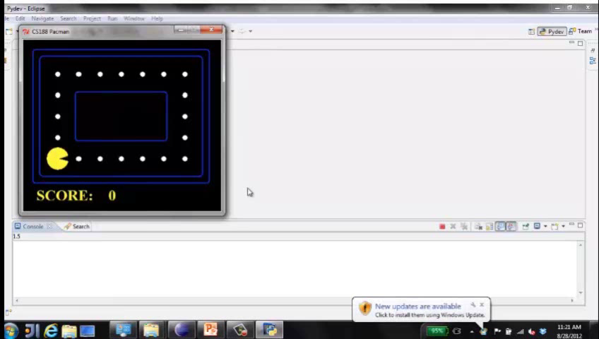
Video of Demo Reflex Optimal

Slide 6
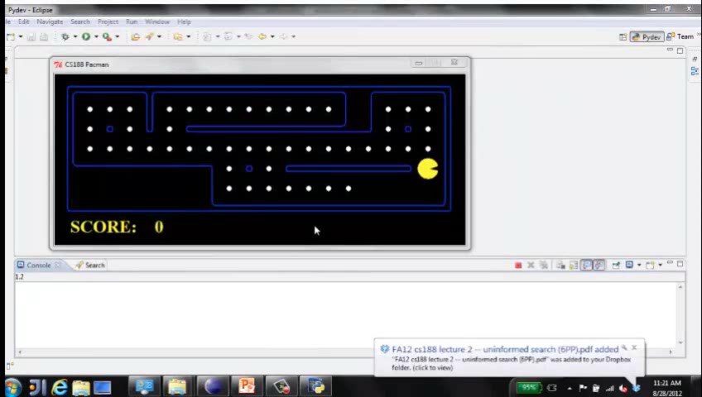
Video of Demo Reflex Odd

Slide 7
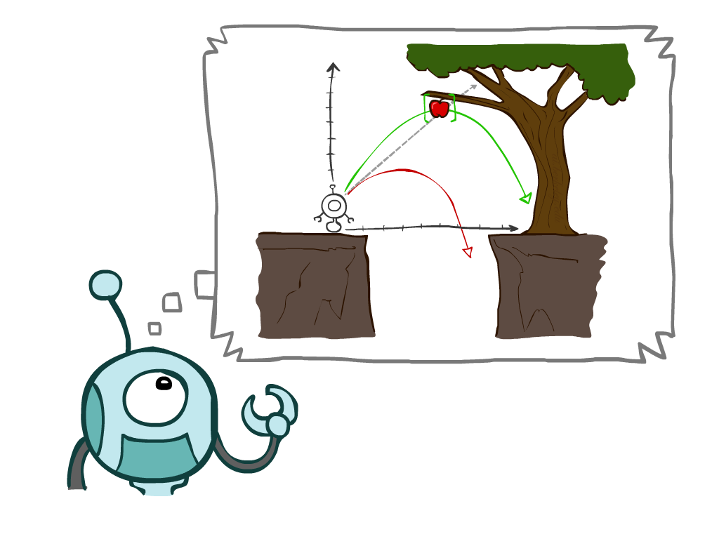
Agents that Plan

Slide 8
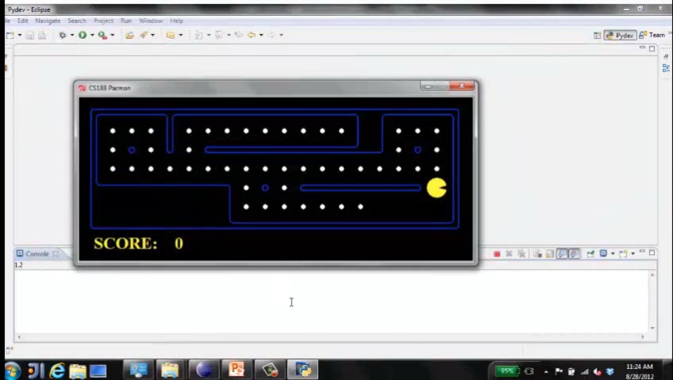
Video of Demo Replanning

Slide 9
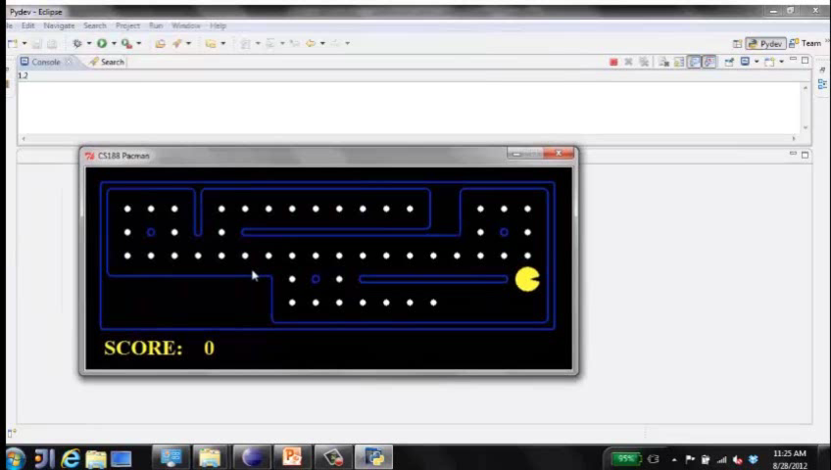
Video of Demo Mastermind

Slide 10

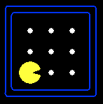
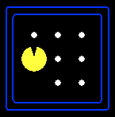
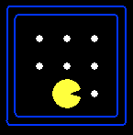



Search Formal Definition
A search problem consists of:
A state space
A successor function
(with actions, costs)
A start state and a goal test
A solution is a sequence of actions (a plan) which transforms the start state to a goal state
“N”, 1.0
“E”, 1.0
Notes:
Often comes back on exams
Goal test – sometimes more than one state that satisfies having achieved the goal, for example, “eat all the dots”
Abstraction

Slide 11

Why Should you Care?
Driving to a destination
Planning for an Exam
Playing Chess
Solving Mathematical Problems
…
Notes:
General theme in the class:
A goal we have in mind.
A mathematical abstraction to formalize this
Algorithms that operate on these abstractions

Slide 12

Wildlife Cares
Notes:
Please retain proper attribution, including the reference to ai.berkeley.edu. Thanks!

Slide 13
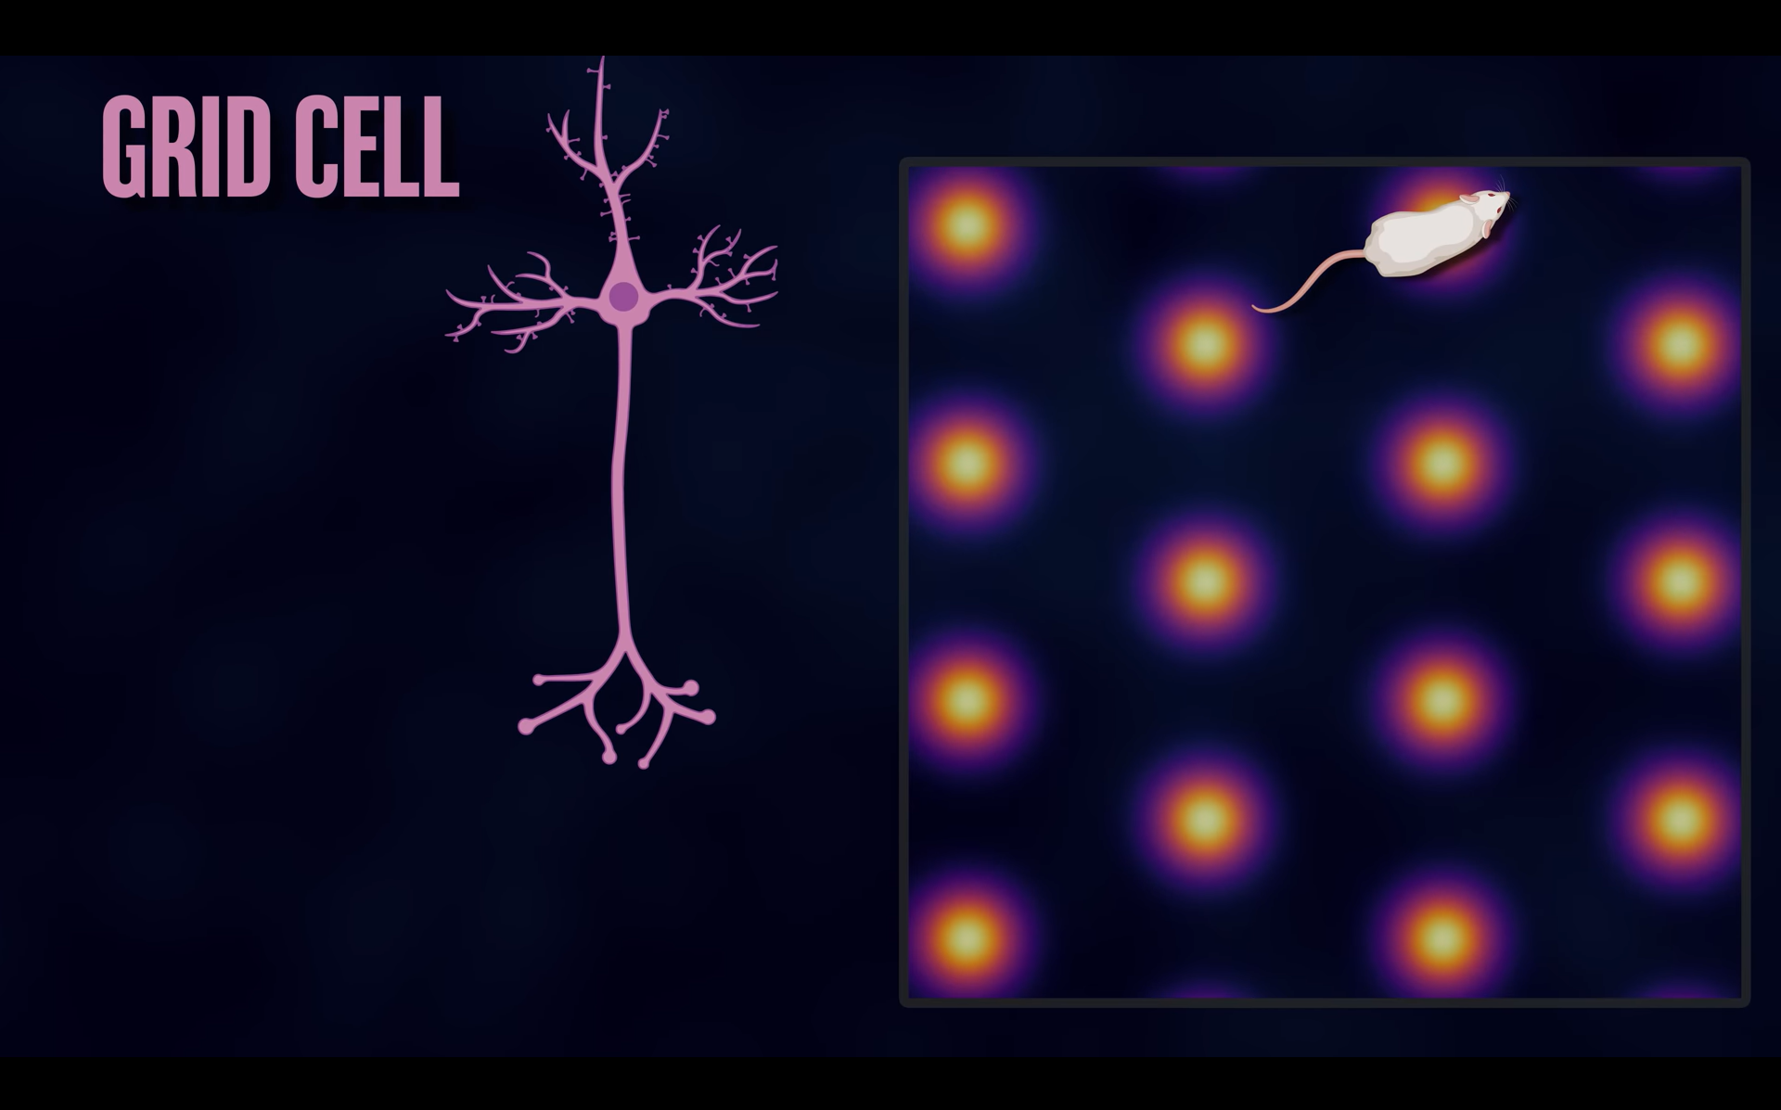
Your Brain Cares
Notes:
Please retain proper attribution, including the reference to ai.berkeley.edu. Thanks!

Slide 14
Why do we Care?
Doing Drug Discovery (Gflownets)
Creating Chatbots (Beam Search)
Winning world Champion in Chess and Go (Alpha-Zero)
Automated Theorem Proving (Alpha-Geometry)
Delivery Systems
Factory Robots
Solving CSP problems
Program Induction (Dream Coder)
Symbolic Regression (AI Feynman )
Routing Protocols (OSPF)
…
Notes:
General theme in the class:
A goal we have in mind.
A mathematical abstraction to formalize this
Algorithms that operate on these abstractions

Slide 15
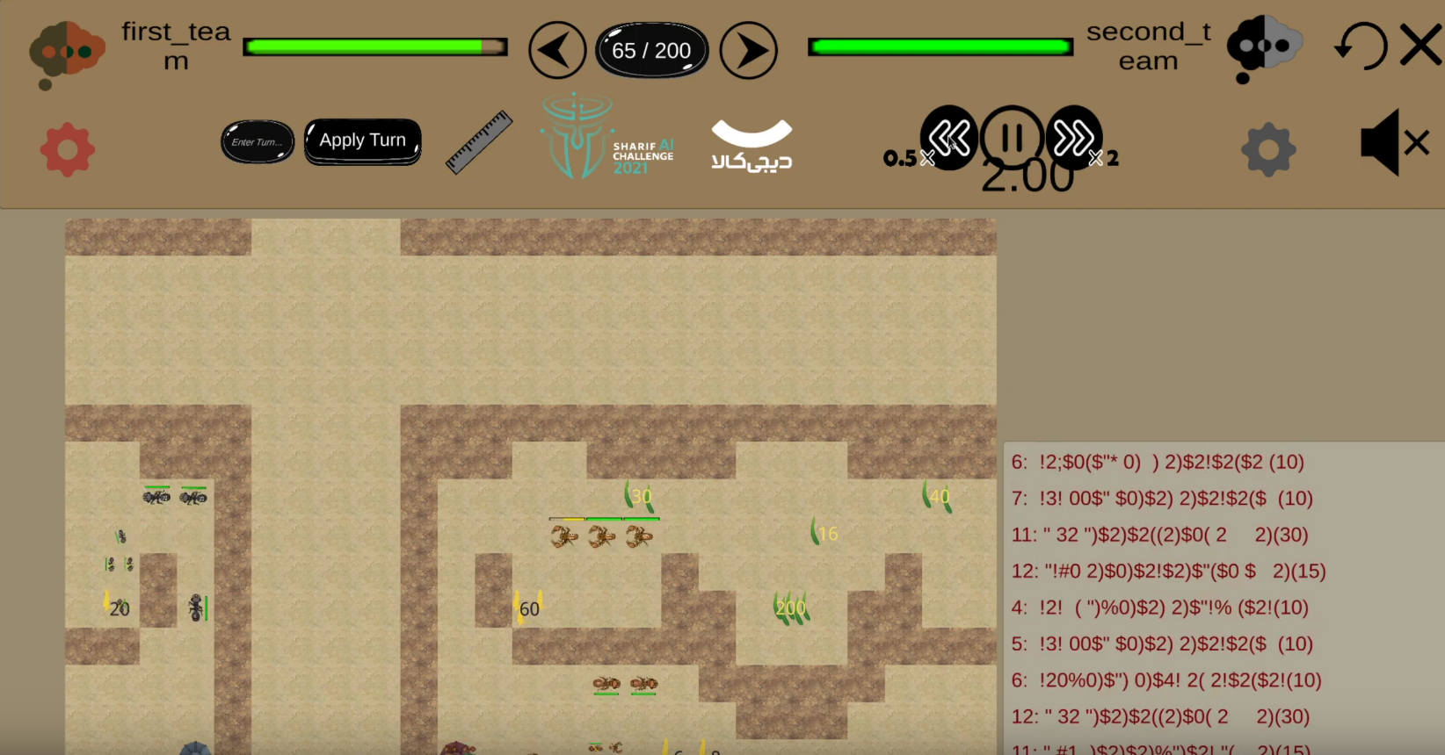
My Personal Story with Search
Won the Sharif AI challenge of 2021
Got 8 million as prize
Used search algorithms in our code.
https://github.com/aalaei/AI21/blob/main/client-server-fused/src/agent/routing/SS.java
Demo: D:\projects\comps\AIC-sharif\AIC21\AIC21-Game\visualizer\WindowsV1.5.3

Slide 16
Example: Traveling in Romania
State space:
Cities
Successor function:
Roads: Go to adjacent city with cost = distance
Start state:
Arad
Goal test:
Is state == Bucharest?
Solution?

Slide 17
State Space Graphs
State space graph: A mathematical representation of a search problem
Nodes are (abstracted) world configurations
Arcs represent successors (action results)
The goal test is a set of goal nodes (maybe only one)
In a state space graph, each state occurs only once!
We can rarely build this full graph in memory (it’s too big), but it’s a useful idea

Slide 18
Search Trees
This is now / start
“N”, 1.0
“E”, 1.0
Possible futures
A search tree:
A “what if” tree of plans and their outcomes
The start state is the root node
Children correspond to successors
Nodes show states, but correspond to PLANS that achieve those states
For most problems, we can never actually build the whole tree
Notes:
Different plans that achieve the same state, will be different nodes in the tree.

Slide 19
State Space Graphs vs. Search Trees
State Space Graph
Each NODE in in the search tree is an entire PATH in the state space graph.
Search Tree
S
a
G
d
e
p
b
c
q
b
c
e
h
r
d
e
f
a
a
h
r
p
q
f
S
h
We construct both on demand – and we construct as little as possible.
p
q
f
q
c
G
p
q
r
q
c
G
a
a

Slide 20

Quiz: State Space Graphs vs. Search Trees
Consider this 4-state graph:
How big is its search tree (from S)?
a
s
a
b
S
G
b
G
a
G
b
a
G
b
G
…
…
Important: Lots of repeated structure in the search tree!

Slide 21
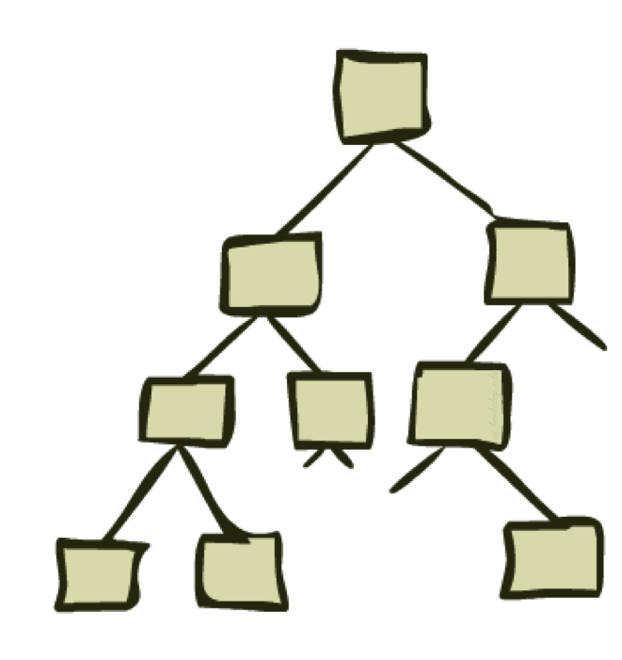
Tree Search

Slide 22
Search Example: Romania

Slide 23
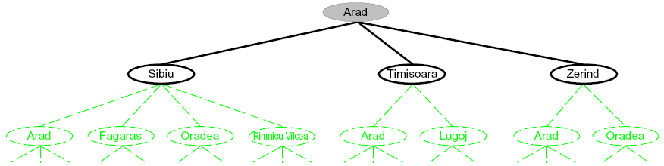
Searching with a Search Tree
Search:
Expand out potential plans (tree nodes)
Maintain a fringe of partial plans under consideration
Try to expand as few tree nodes as possible

Slide 24
General Tree Search
Important ideas:
Fringe
Expansion
Exploration strategy
Main question: which fringe nodes to explore?

Slide 25
Example: Tree Search
a
G
b
c
d
e
f
S
h
p
q
r
Notes:
Left: show tree
Right: fringe

Slide 26
Example: Tree Search
a
G
b
c
e
d
e
d
f
f
S
h
p
r
q
r
S
s
s → d
s → e
s → p
s → d → b
s → d → c
s → d → e
s → d → e → h
s → d → e → r
s → d → e → r → f
s → d → e → r → f → c
s → d → e → r → f → G
d
e
p
b
c
e
h
r
q
a
a
h
r
p
q
f
p
q
f
q
c
G
q
c
G
a
a

Slide 27

Depth-First Search

Slide 28
Depth-First Search
Strategy: expand a deepest node first
Implementation: Fringe is a LIFO stack
a
G
a
c
b
c
b
e
d
e
d
f
f
S
h
h
p
p
r
q
r
q
S
d
e
p
b
c
e
h
r
q
a
a
h
r
p
q
f
p
q
f
q
c
G
q
c
G
a
a

Slide 29
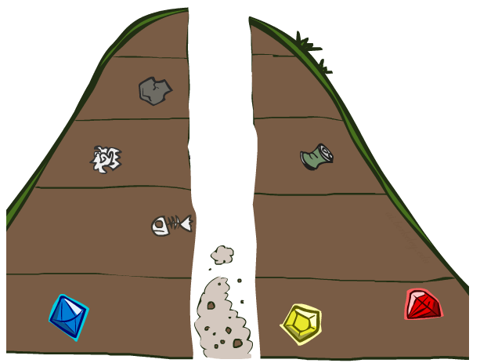
Search Algorithm Properties

Slide 30
Search Algorithm Properties
Complete: Guaranteed to find a solution if one exists?
Optimal: Guaranteed to find the least cost path?
Time complexity?
Space complexity?
Cartoon of search tree:
b is the branching factor
m is the maximum depth
solutions at various depths
Number of nodes in entire tree?
1 + b + b² + …. b^{m} = O(b^{m})
1 node
b
…
b nodes
b² nodes
m tiers
b^{m} nodes

Slide 31
Depth-First Search (DFS) Properties
What nodes DFS expand?
Some left prefix of the tree.
Could process the whole tree!
If m is finite, takes time O(b^{m})
How much space does the fringe take?
Only has siblings on path to root, so O(bm)
Is it complete?
m could be infinite, so only if we prevent that
Is it optimal?
No, it finds the “leftmost” solution, regardless of depth or cost
1 node
b
…
b nodes
b² nodes
m tiers
b^{m} nodes

Slide 32
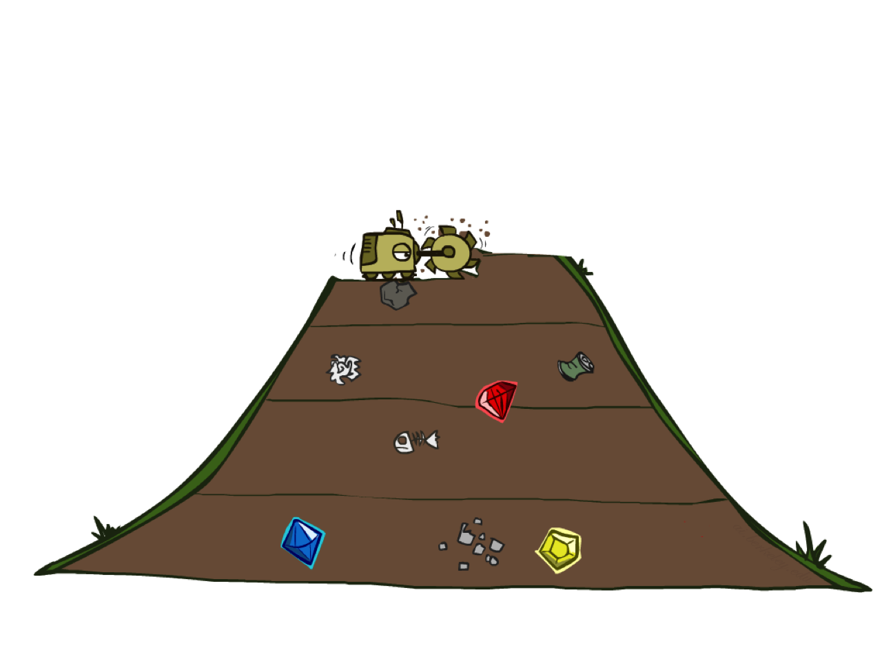
Breadth-First Search

Slide 33
Breadth-First Search
Strategy: expand a shallowest node first
Implementation: Fringe is a FIFO queue
a
G
b
c
d
e
f
S
h
p
q
r
S
d
e
p
Search
Tiers
b
c
e
h
r
q
a
a
h
r
p
q
f
p
q
f
q
c
G
q
c
G
a
a

Slide 34
Breadth-First Search (BFS) Properties
What nodes does BFS expand?
Processes all nodes above shallowest solution
Let depth of shallowest solution be s
Search takes time O(b^{s})
How much space does the fringe take?
Has roughly the last tier, so O(b^{s})
Is it complete?
s must be finite if a solution exists, so yes!
Is it optimal?
Only if costs are all 1 (more on costs later)
1 node
b
…
b nodes
s tiers
b² nodes
b^{s} nodes
b^{m} nodes

Slide 35
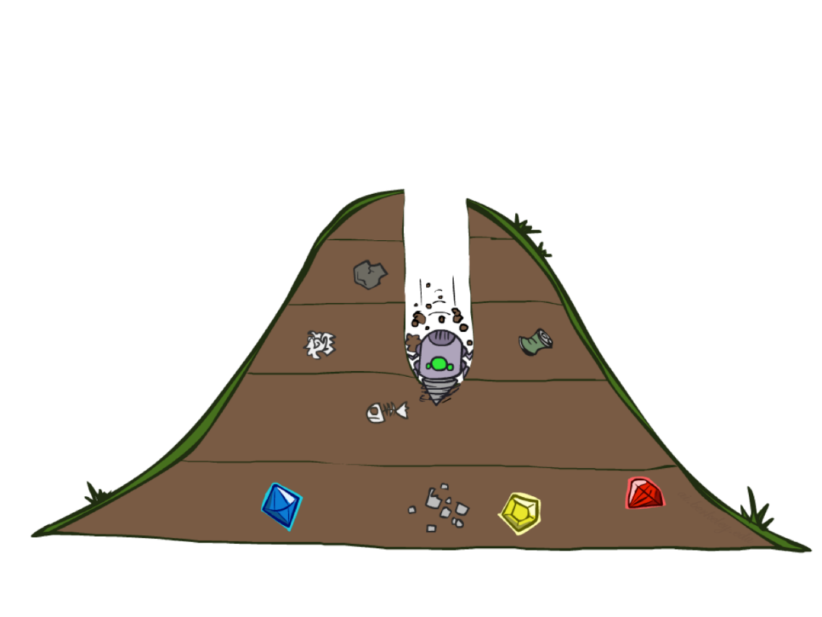
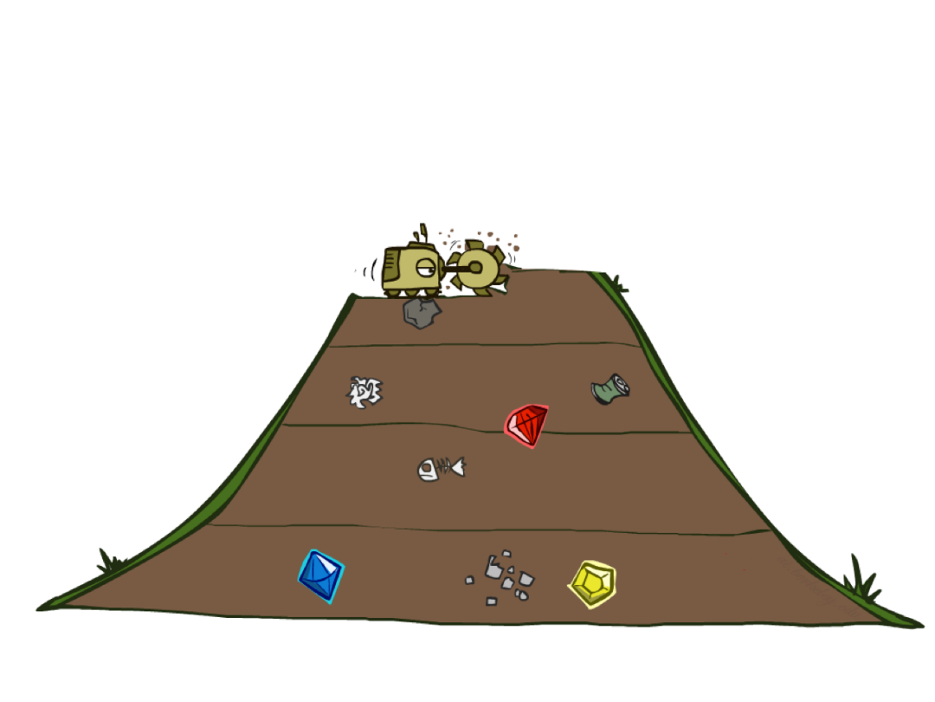
Quiz: DFS vs BFS

Slide 36
Quiz: DFS vs BFS
When will BFS outperform DFS?
When will DFS outperform BFS?
[Demo: dfs/bfs maze water (L2D6)]

Slide 37

Video of Demo Maze Water DFS/BFS (part 1)

Slide 38
Video of Demo Maze Water DFS/BFS (part 2)

Slide 39
Cost-Sensitive Search
a
GOAL
2
2
b
c
3
2
1
8
2
e
d
f
3
9
8
2
START
h
1
4
2
p
4
r
15
q
BFS finds the shortest path in terms of number of actions.
It does not find the least-cost path. We will now cover
a similar algorithm which does find the least-cost path.

Slide 40

Uniform Cost Search

Slide 41
Uniform Cost Search
2
G
a
Strategy: expand a cheapest node first:
Fringe is a priority queue (priority: cumulative cost)
b
c
1
8
2
2
e
3
d
f
9
8
2
S
h
1
1
p
q
r
15
0
S
d
3
e
9
p
1
b
4
e
5
h
17
r
11
q
16
c
11
Cost contours
a
6
a
h
13
r
7
p
q
f
p
q
f
8
q
c
G
q
c
a
11
G
10
a

Slide 42
Uniform Cost Search (UCS) Properties
What nodes does UCS expand?
Processes all nodes with cost less than cheapest solution!
If that solution costs C* and arcs cost at least ε , then the “effective depth” is roughly C*/ε
Takes time O(b^{C*/ε}) (exponential in effective depth)
How much space does the fringe take?
Has roughly the last tier, so O(b^{C*/ε})
Is it complete?
Assuming best solution has a finite cost and minimum arc cost is positive, yes!
Is it optimal?
Yes! (Proof next lecture via A*)
b
c ≤ 1
…
C*/ε “tiers”
c ≤ 2
c ≤ 3

Slide 43
Uniform Cost Issues
Remember: UCS explores increasing cost contours
The good: UCS is complete and optimal!
The bad:
Explores options in every “direction”
No information about goal location
We’ll fix that soon!
…
c ≤ 1
c ≤ 2
c ≤ 3
Start
Goal
[Demo: empty grid UCS (L2D5)]
[Demo: maze with deep/shallow water DFS/BFS/UCS (L2D7)]

Slide 44
Video of Demo Contours UCS Pacman Small Maze

Slide 45
Video of Demo Empty UCS

Slide 46
Video of Demo Maze with Deep/Shallow Water --- DFS, BFS, or UCS? (part 1)
Notes:
Let students guess which one of the three it is. (This is BFS.)

Slide 47
Video of Demo Maze with Deep/Shallow Water --- DFS, BFS, or UCS? (part 2)
Notes:
Let students guess which one of the three it is. (This is UCS.)

Slide 48
Video of Demo Maze with Deep/Shallow Water --- DFS, BFS, or UCS? (part 3)
Notes:
Let students guess which one of the three it is. (This is DFS.)

Slide 49
Example: Pancake Problem
Cost: Number of pancakes flipped
Notes:
Gates, W. and Papadimitriou, C., "Bounds for Sorting by Prefix Reversal.", Discrete Mathematics. 27, 47-57, 1979.

Slide 50
Example: Pancake Problem
State space graph with costs as weights
4
2
3
2
3
4
3
4
2
3
2
2
4
3
Notes:
A* expanded 8100 ; Path cost = 33
UCS expanded 25263 . Path cost = 33
Greedy expanded 10 . Path cost = 41
[0, 7, 5, 3, 2, 1, 4, 6]
(7, 0, 5, 3, 2, 1, 4, 6)
(6, 4, 1, 2, 3, 5, 0, 7)
(3, 2, 1, 4, 6, 5, 0, 7)
(1, 2, 3, 4, 6, 5, 0, 7)
(5, 6, 4, 3, 2, 1, 0, 7)
(6, 5, 4, 3, 2, 1, 0, 7)
(0, 1, 2, 3, 4, 5, 6, 7)

Slide 51
General Tree Search
Action: flip top two Cost: 2
Action: flip all four Cost: 4
Path to reach goal:
Flip four, flip three
Total cost: 7
Notes:
You know exactly where you came from and how you got there, but you have no idea where you’re going. But, you’ll know it when you see it.

Slide 52

Informed Search

Slide 53



Search Heuristics
A heuristic is:
A function that estimates how close a state is to a goal
Designed for a particular search problem
Examples: Manhattan distance, Euclidean distance for pathing
10
5
11.2

Slide 54
Example: Heuristic Function
h(x)

Slide 55
Example: Heuristic Function
Heuristic: the number of the largest pancake that is still out of place
3
h(x)
4
3
4
3
0
4
4
3
4
4
2
3
Notes:
A* expanded 8100 ; Path cost = 33
UCS expanded 25263 . Path cost = 33
Greedy expanded 10 . Path cost = 41
[0, 7, 5, 3, 2, 1, 4, 6]
(7, 0, 5, 3, 2, 1, 4, 6)
(6, 4, 1, 2, 3, 5, 0, 7)
(3, 2, 1, 4, 6, 5, 0, 7)
(1, 2, 3, 4, 6, 5, 0, 7)
(5, 6, 4, 3, 2, 1, 0, 7)
(6, 5, 4, 3, 2, 1, 0, 7)
(0, 1, 2, 3, 4, 5, 6, 7)

Slide 56

Greedy Search

Slide 57
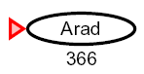
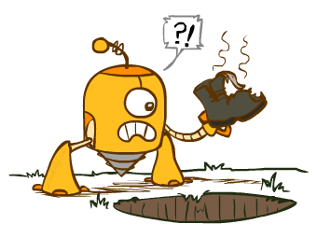
Greedy Search
Expand the node that seems closest…
What can go wrong?

Slide 58
Greedy Search
b
Strategy: expand a node that you think is closest to a goal state
Heuristic: estimate of distance to nearest goal for each state
A common case:
Best-first takes you straight to the (wrong) goal
Worst-case: like a badly-guided DFS
…
b
…
[Demo: contours greedy empty (L3D1)]
[Demo: contours greedy pacman small maze (L3D4)]
Notes:
For any search problem, you know the goal. Now, you have an idea of how far away you are from the goal.

Slide 59
Video of Demo Contours Greedy (Empty)

Slide 60
Video of Demo Contours Greedy (Pacman Small Maze)

Slide 61
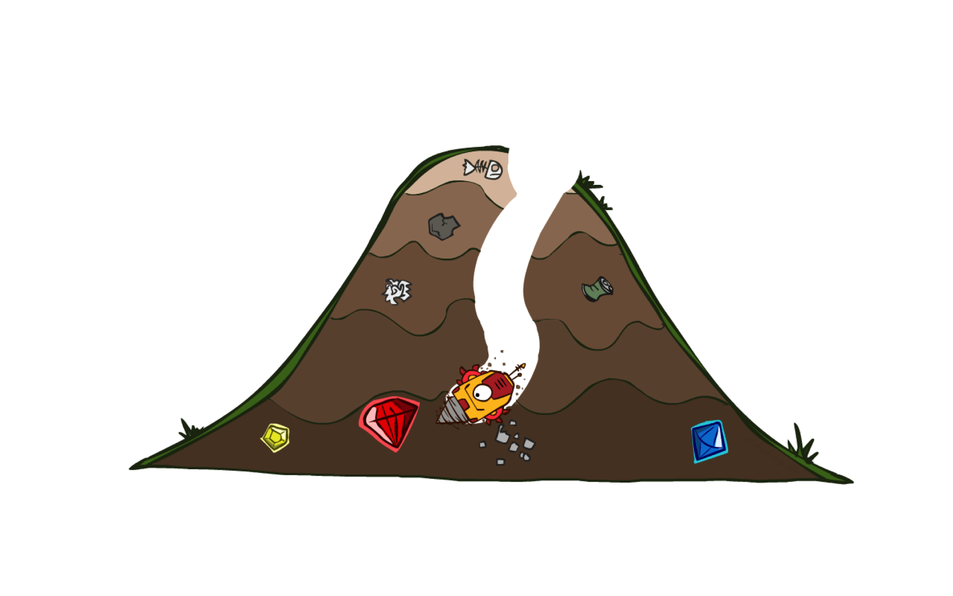
A* Search

Slide 62

A* Search
UCS
Greedy
A*
Notes:
Notes: these images licensed from iStockphoto for UC Berkeley use.

Slide 63
Uniform-Cost Search
g = 0
8
S
e
h=1
g = 1
a
1
S
1
a
3
d
2
G
g = 2
g = 4
g = 9
h=6
h=5
b
d
e
1
h=2
h=0
c
1
b
g = 3
g = 6
h=7
h=6
c
G
Example: Teg Grenager
Notes:
Go through steps of algorithm for each

Slide 64
Greedy Search
h=6
8
S
e
h=1
h=5
a
1
S
1
a
3
d
2
G
h=6
h=2
h=1
h=6
h=5
b
d
e
1
h=2
h=0
c
1
b
h=7
h=6
d
h=2
h=0
G
Example: Teg Grenager
Notes:
Go through steps of algorithm for each

Slide 65
Combining UCS and Greedy
Uniform-cost orders by path cost, or backward cost g(n)
Greedy orders by goal proximity, or forward cost h(n)
A* Search orders by the sum: f(n) = g(n) + h(n)
8
e
h=1
1
1
3
2
S
a
d
G
h=6
1
h=5
h=2
h=0
1
c
b
h=7
h=6
Example: Teg Grenager
Notes:
Go through steps of algorithm for each

Slide 66
Combining UCS and Greedy
Uniform-cost orders by path cost, or backward cost g(n)
Greedy orders by goal proximity, or forward cost h(n)
A* Search orders by the sum: f(n) = g(n) + h(n)
8
S
f=0+6
e
h=1
a
1
f = 1+5
1
3
2
S
a
d
G
b
d
e
h=6
1
h=5
f = 2+6
f = 4+2
f = 9+1
h=2
h=0
1
c
b
G
h=7
h=6
f = 6+0
Example: Teg Grenager
Notes:
Go through steps of algorithm for each

Slide 67
When should A* terminate?
Should we stop when we enqueue a goal?
No: only stop when we dequeue a goal
h = 2
f=0+3
S
A
2
2
f = 2+2
f = 2+1
S
h = 3
h = 0
G
A
B
2
B
3
f = 4+0
f = 5+0
G
G
h = 1

Slide 68
Is A* Optimal?
h = 6
f=0+7
1
A
3
S
f = 1+6
f = 5+0
A
G
S
h = 7
G
h = 0
5
What went wrong?
Actual bad goal cost < estimated good goal cost
We need estimates to be less than actual costs!

Slide 69

Admissible Heuristics

Slide 70

Idea: Admissibility
Inadmissible (pessimistic) heuristics break optimality by trapping good plans on the fringe
Admissible (optimistic) heuristics slow down bad plans but never outweigh true costs

Slide 71


Admissible Heuristics
A heuristic h is admissible (optimistic) if:
where is the true cost to a nearest goal
Examples:
Coming up with admissible heuristics is most of what’s involved in using A* in practice.
4
15

Slide 72
Properties of A*
Uniform-Cost
A*
b
b
…
…

Slide 73
UCS vs A* Contours
Uniform-cost expands equally in all “directions”
A* expands mainly toward the goal, but does hedge its bets to ensure optimality
Start
Goal
Start
Goal
[Demo: contours UCS / greedy / A* empty (L3D1)]
[Demo: contours A* pacman small maze (L3D5)]

Slide 74
Video of Demo Contours (Empty) -- UCS

Slide 75
Video of Demo Contours (Empty) -- Greedy

Slide 76
Video of Demo Contours (Empty) – A*

Slide 77
Video of Demo Contours (Pacman Small Maze) – A*

Slide 78



Comparison
Greedy
Uniform Cost
A*

Slide 79
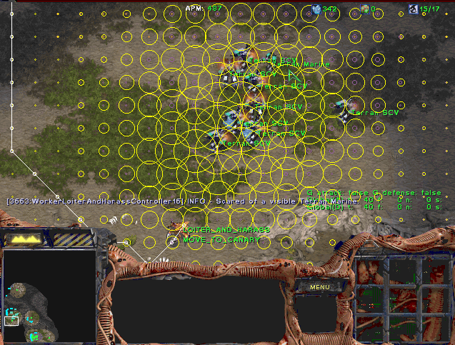
A* Applications
Video games
Pathing / routing problems
Resource planning problems
Robot motion planning
Language analysis
Machine translation
Speech recognition
…
[Demo: UCS / A* pacman tiny maze (L3D6,L3D7)]
[Demo: guess algorithm Empty Shallow/Deep (L3D8)]

Slide 80
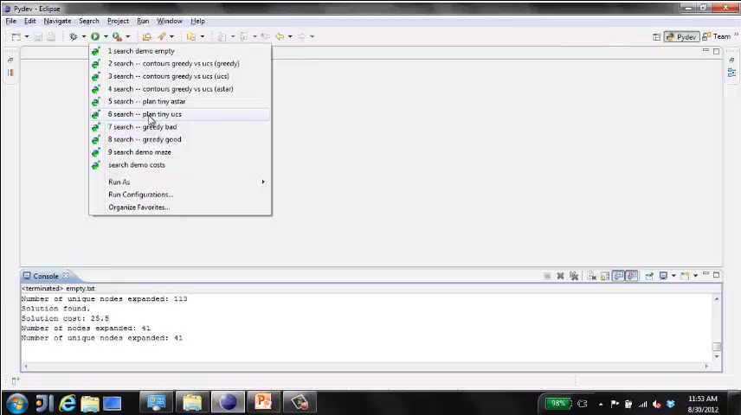
Video of Demo Pacman (Tiny Maze) – UCS / A*

Slide 81
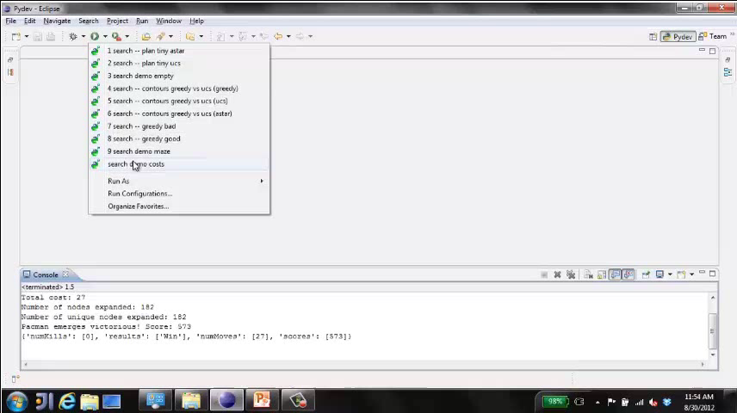
Video of Demo Empty Water Shallow/Deep – Guess Algorithm

Slide 82
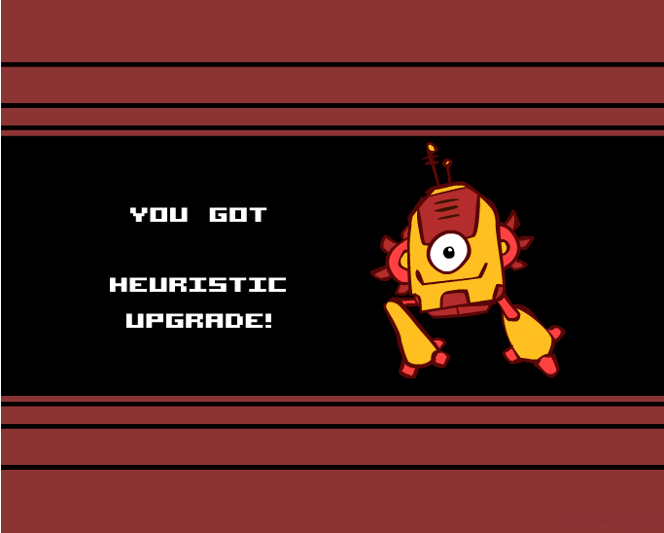
Creating Heuristics

Slide 83
Creating Admissible Heuristics
Most of the work in solving hard search problems optimally is in coming up with admissible heuristics
Often, admissible heuristics are solutions to relaxed problems, where new actions are available
Inadmissible heuristics are often useful too
366
15

Slide 84
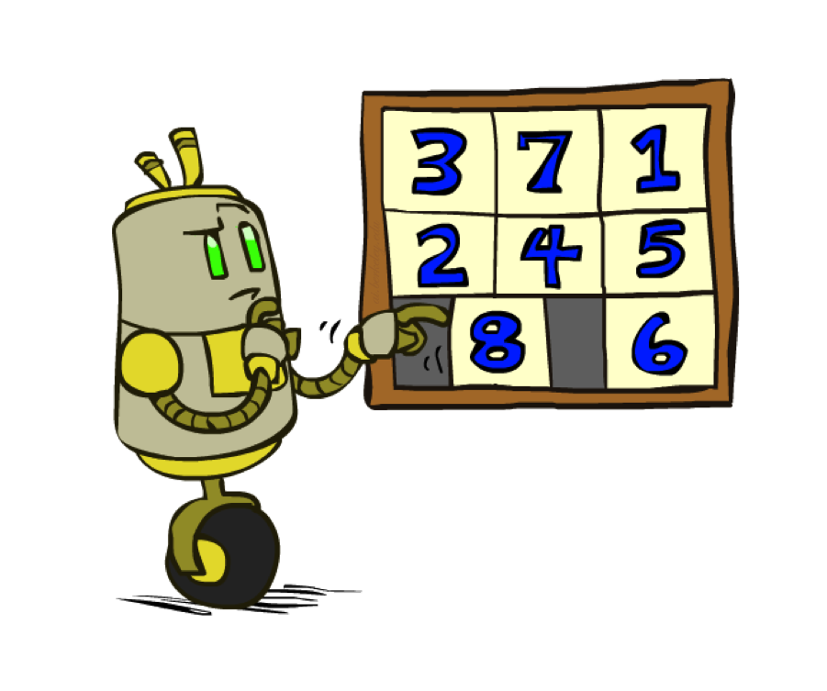
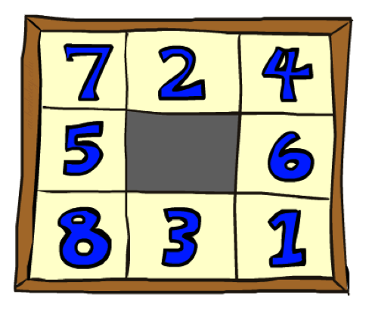
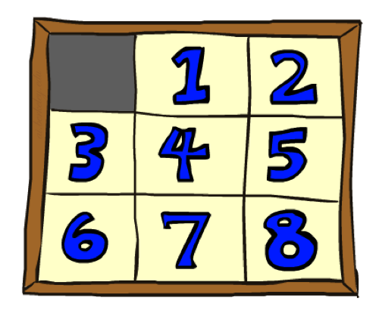
Example: 8 Puzzle
Start State
Actions
Goal State
What are the states?
How many states?
What are the actions?
How many successors from the start state?
What should the costs be?

Slide 85
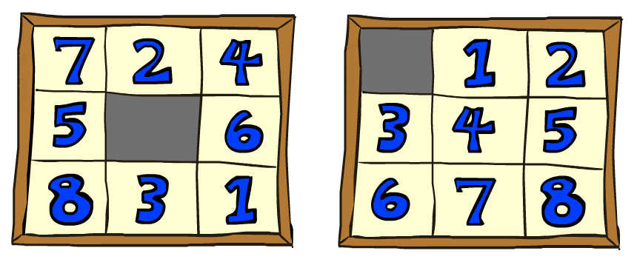
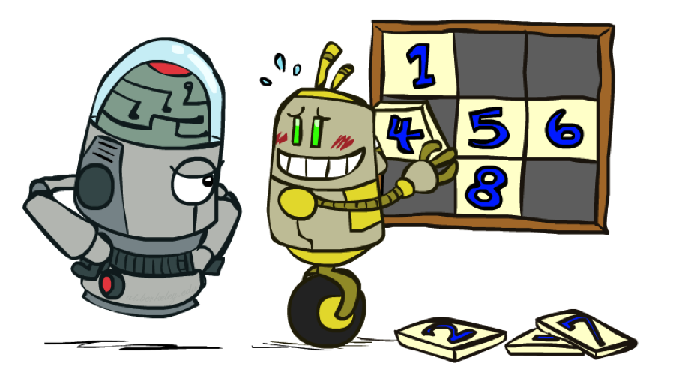
8 Puzzle I
Heuristic: Number of tiles misplaced
Why is it admissible?
h(start) =
This is a relaxed-problem heuristic
8
Start State
Goal State
 | Average nodes expanded when the optimal path has…
 | …4 steps | …8 steps | …12 steps
UCS | 112 | 6,300 | 3.6 x 10⁶
TILES | 13 | 39 | 227
Statistics from Andrew Moore

Slide 86
8 Puzzle II
What if we had an easier 8-puzzle where any tile could slide any direction at any time, ignoring other tiles?
Total Manhattan distance
Why is it admissible?
h(start) =
Start State
Goal State
 | Average nodes expanded when the optimal path has…
 | …4 steps | …8 steps | …12 steps
TILES | 13 | 39 | 227
MANHATTAN | 12 | 25 | 73
3 + 1 + 2 + … = 18

Slide 87
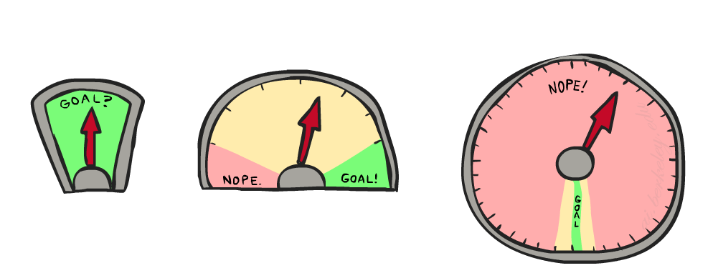
8 Puzzle III
How about using the actual cost as a heuristic?
Would it be admissible?
Would we save on nodes expanded?
What’s wrong with it?
With A*: a trade-off between quality of estimate and work per node
As heuristics get closer to the true cost, you will expand fewer nodes but usually do more work per node to compute the heuristic itself

Slide 88
Semi-Lattice of Heuristics

Slide 89

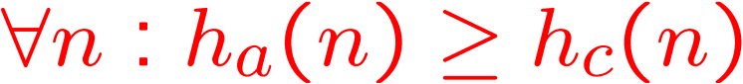
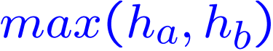

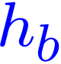


Trivial Heuristics, Dominance
Dominance: h_{a} ≥ h_{c} if
Heuristics form a semi-lattice:
Max of admissible heuristics is admissible
Trivial heuristics
Bottom of lattice is the zero heuristic (what does this give us?)
Top of lattice is the exact heuristic
Notes:
Semi-lattice: x <= y <-> x = x ^ y

Slide 90
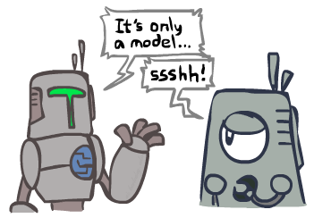
Search and Models
Search operates over models of the world
The agent doesn’t actually try all the plans out in the real world!
Planning is all “in simulation”
Your search is only as good as your models…

Slide 91
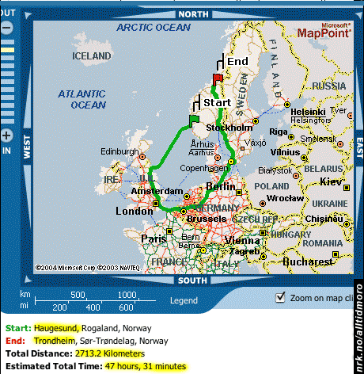
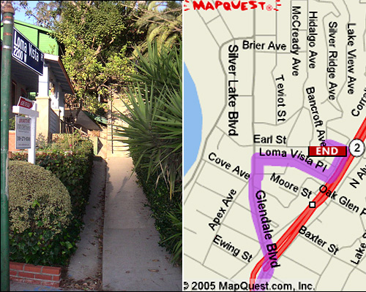
Search Gone Wrong?

Slide 92

Search Gone Wrong?

